Slide 1
A Wearable Self-powered System
Zhenghong Chen
Shan He

Slide 2
Research Questions
1. How to balance the harvested energy from transducer with the load power consumption?
2. How to improve the output power efficiency of the energy harvesting system?

Slide 3
Expected Outcome
1. Choose the suitable energy harvesters
2. Use parallel-SSHI rectifier to increase the output power

Slide 4
Approaches

Slide 5
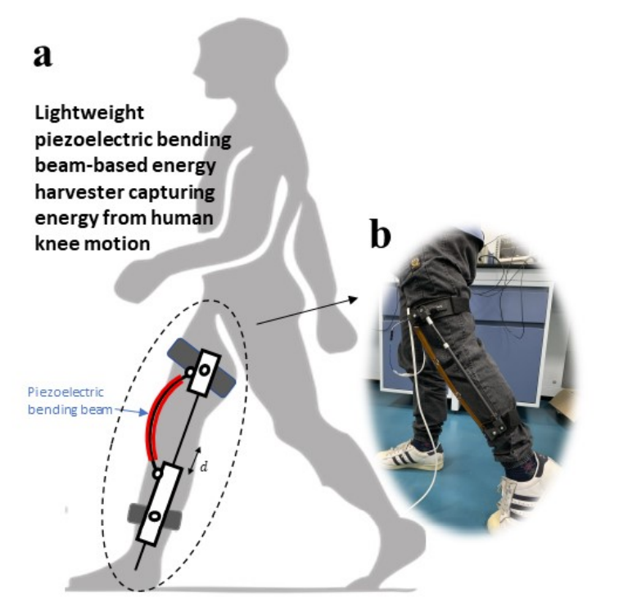
Choose the Piezoelectric Energy Harvester

Slide 6
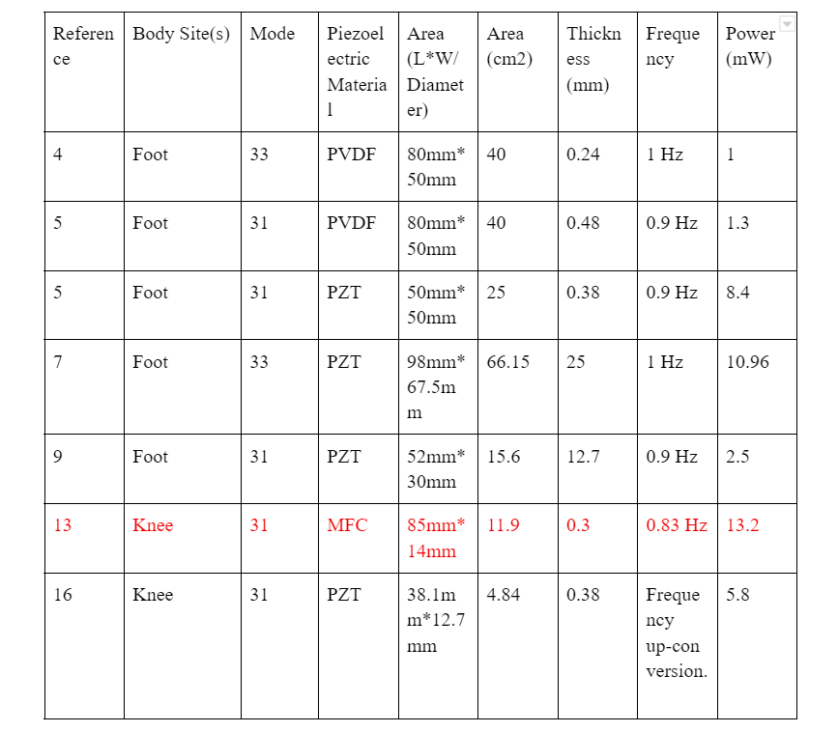
Choose the Piezoelectric Energy Harvester
This energy harvester is put on the knees
MFC
Thin (0.3mm) and Light (290g)
Large output power

Slide 7
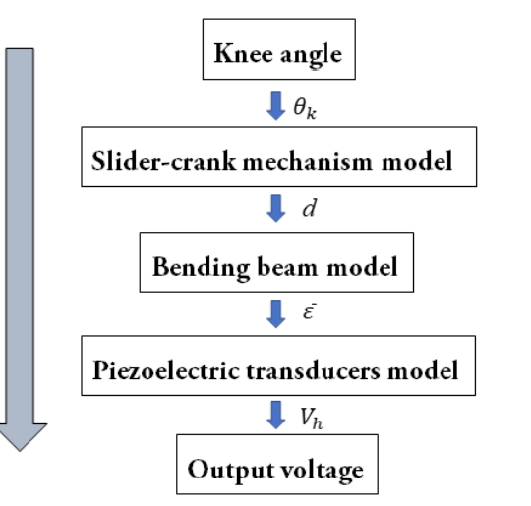
Model the Piezoelectric Energy Harvesting System

Slide 8
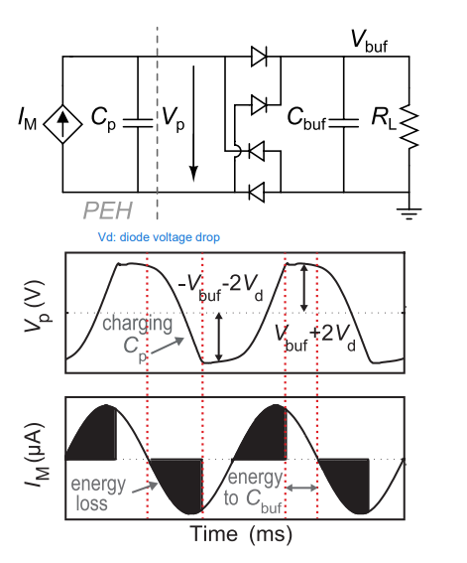
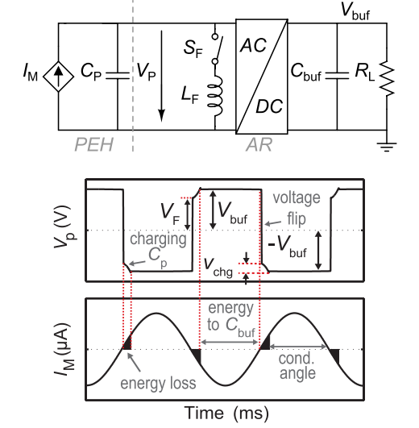
Full-Bridge Rectifier & parallel-SSHI rectifier

Slide 9
Results

Slide 10
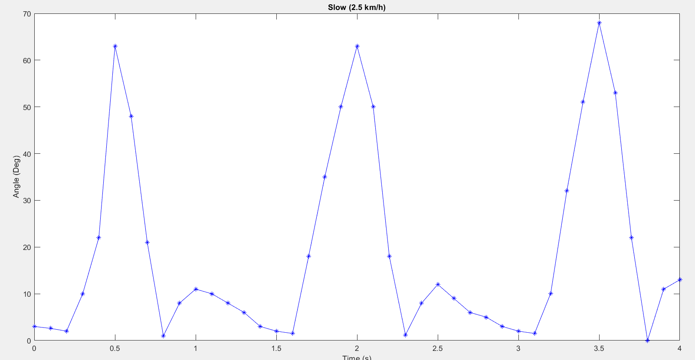
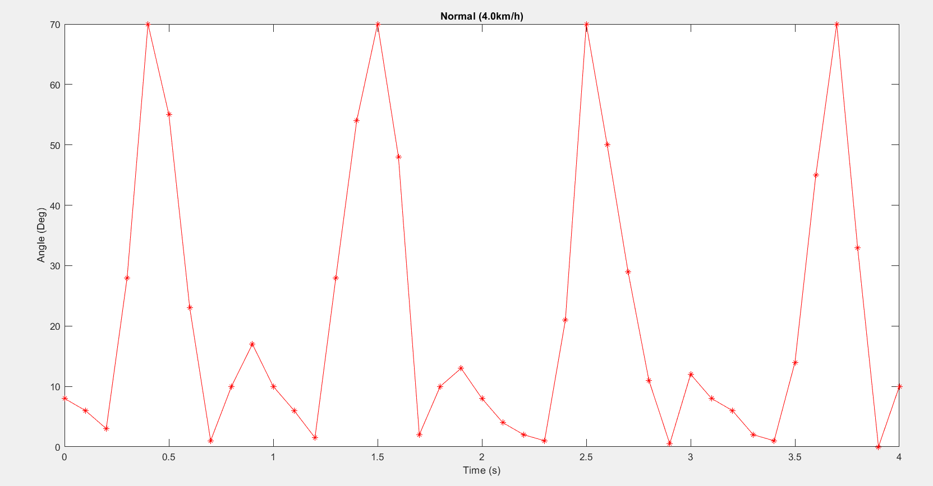
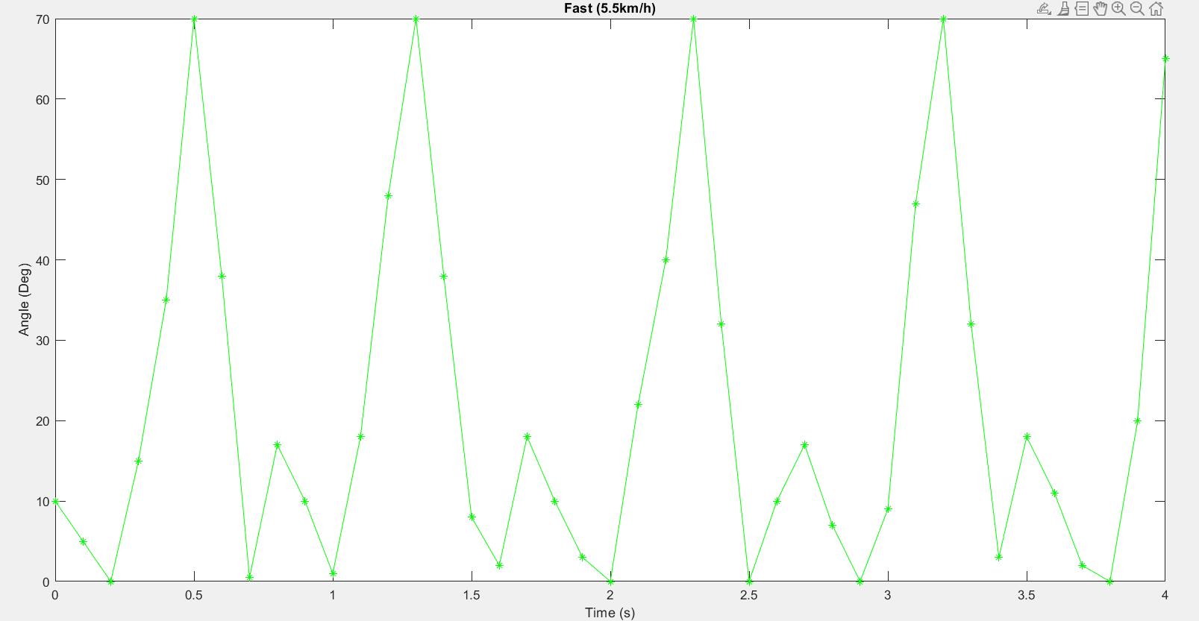
Model the Piezoelectric Energy Harvester
Knee Angle
Blue-Slow (2.5 km/h)
Red-Normal (4.0 km/h)
Green-Fast (5.5 km/h)

Slide 11
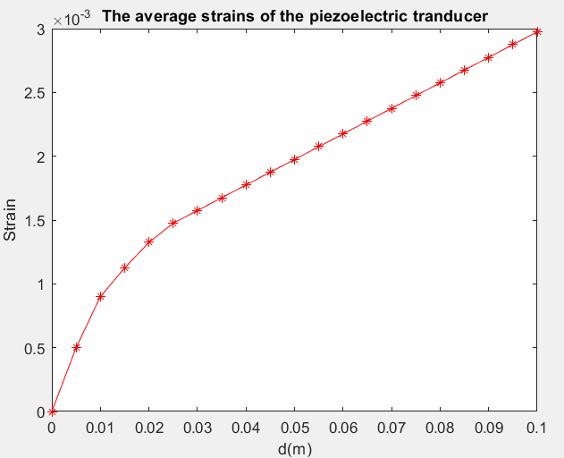
Model the Piezoelectric Energy Harvester
The average strains
The model of slider-crank mechanism
+
The model of bending beam

Slide 12
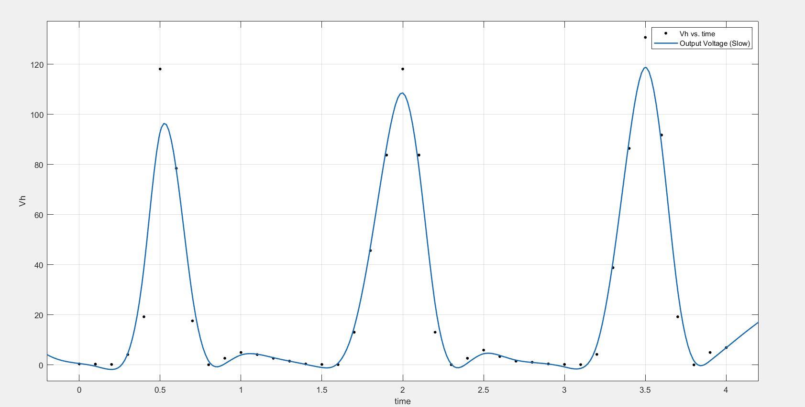
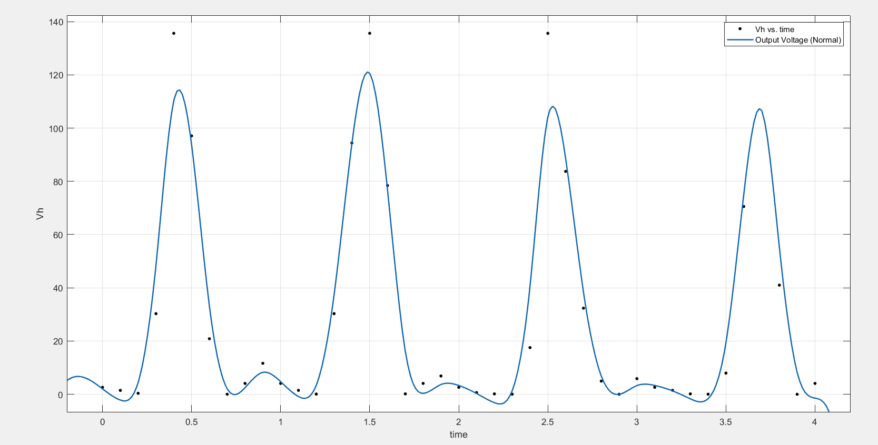
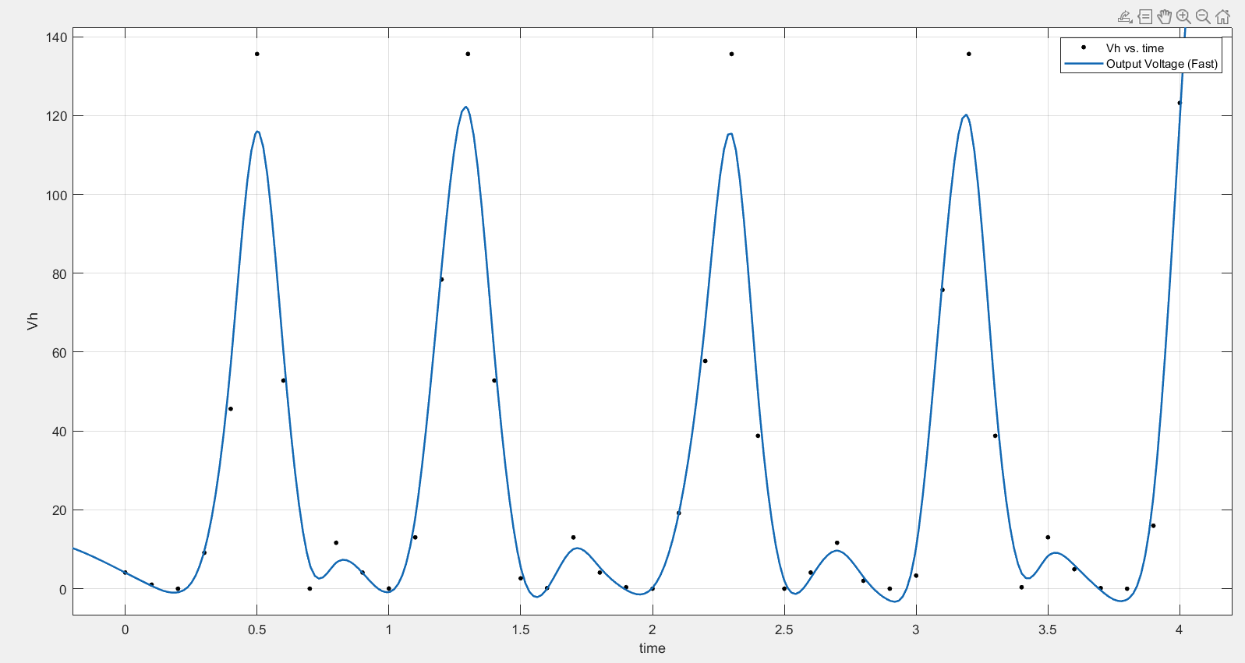
Model the Piezoelectric Energy Harvester
Output Voltage
Slow (2.5 km/h)
Normal (4.0 km/h)
Fast (5.5 km/h)

Slide 13
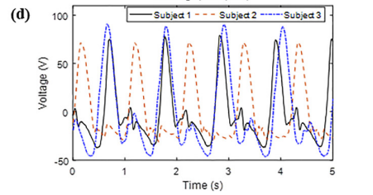
Model the Piezoelectric Energy Harvester
Measured Output Voltage in the paper

Slide 14
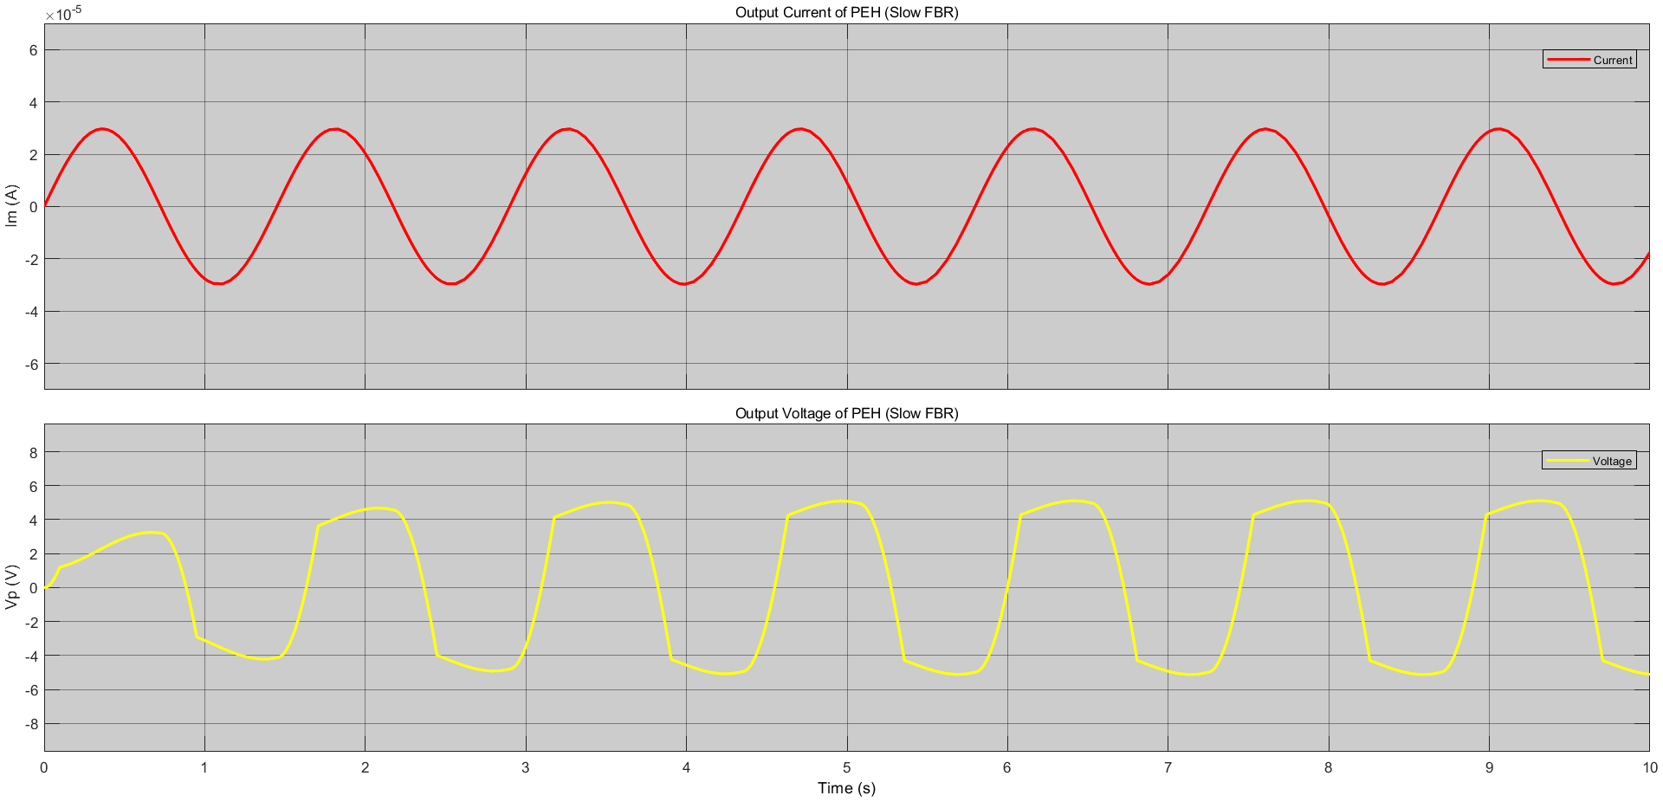
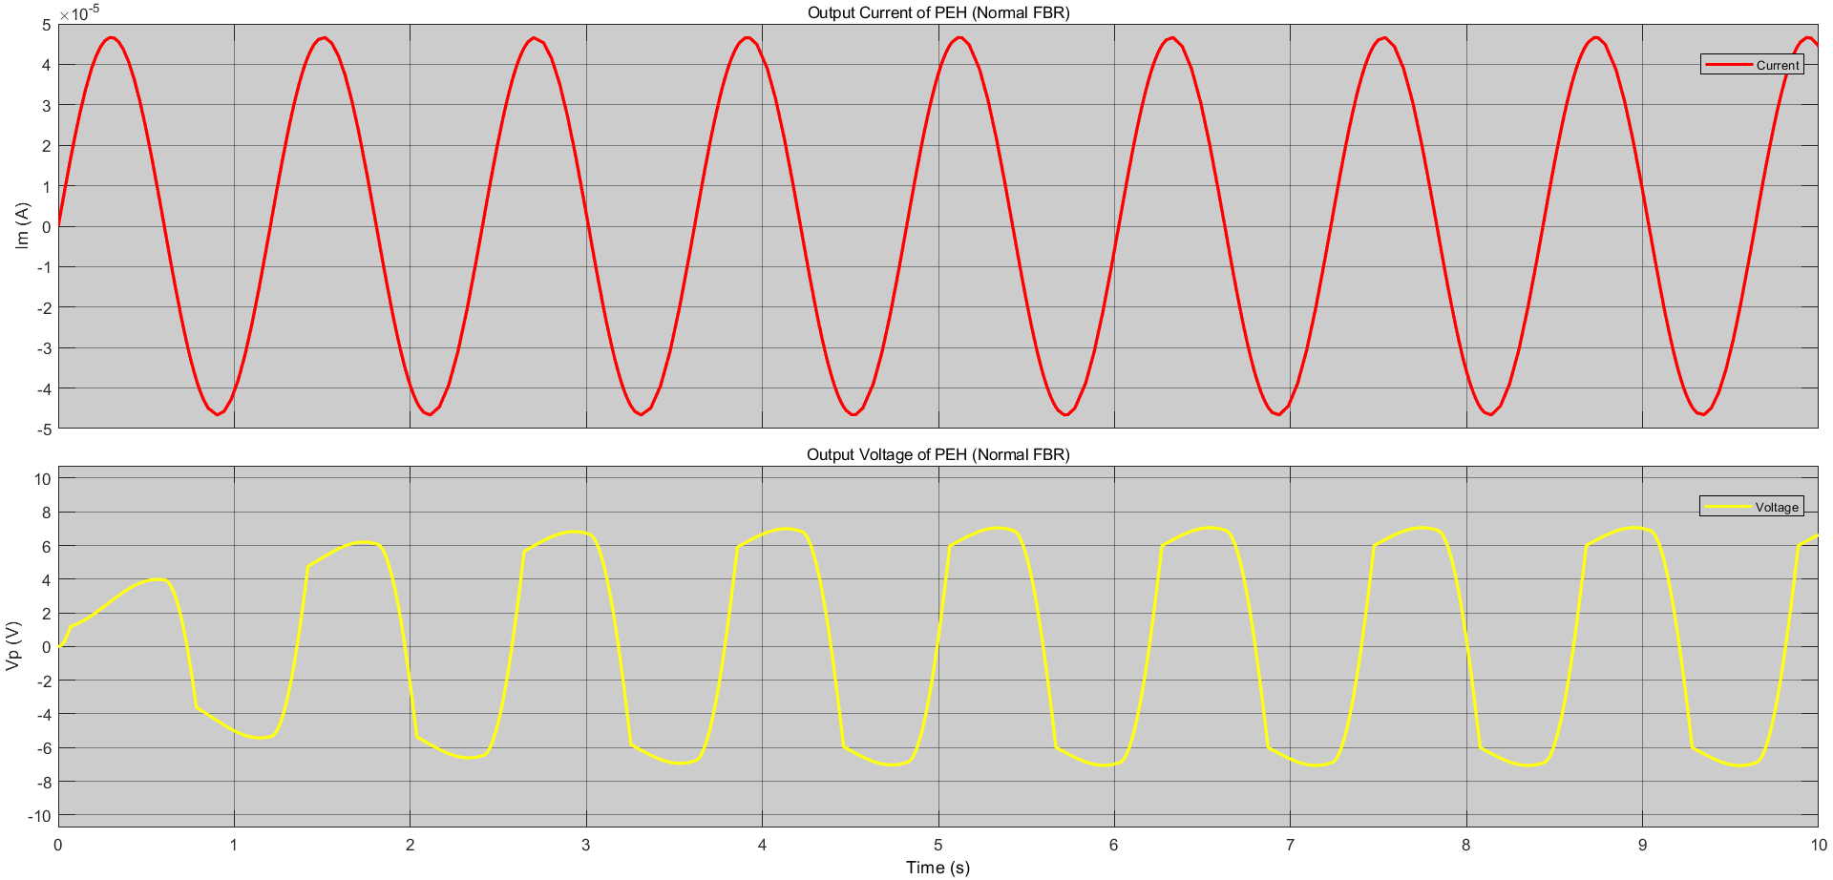
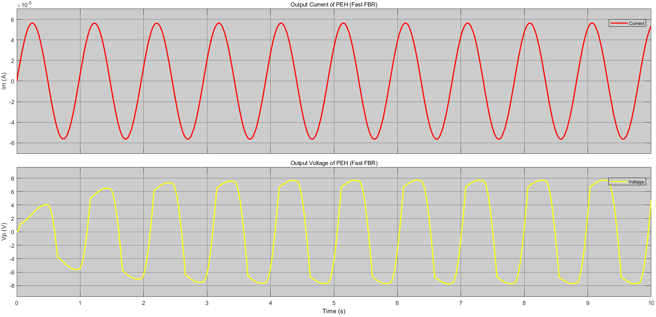
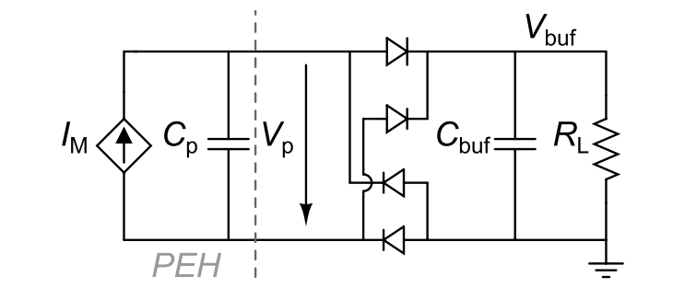
Full-Bridge Rectifier
Output Voltage and Current of PEH
Slow (2.5 km/h)
Normal (4.0 km/h)
Fast (5.5 km/h)

Slide 15
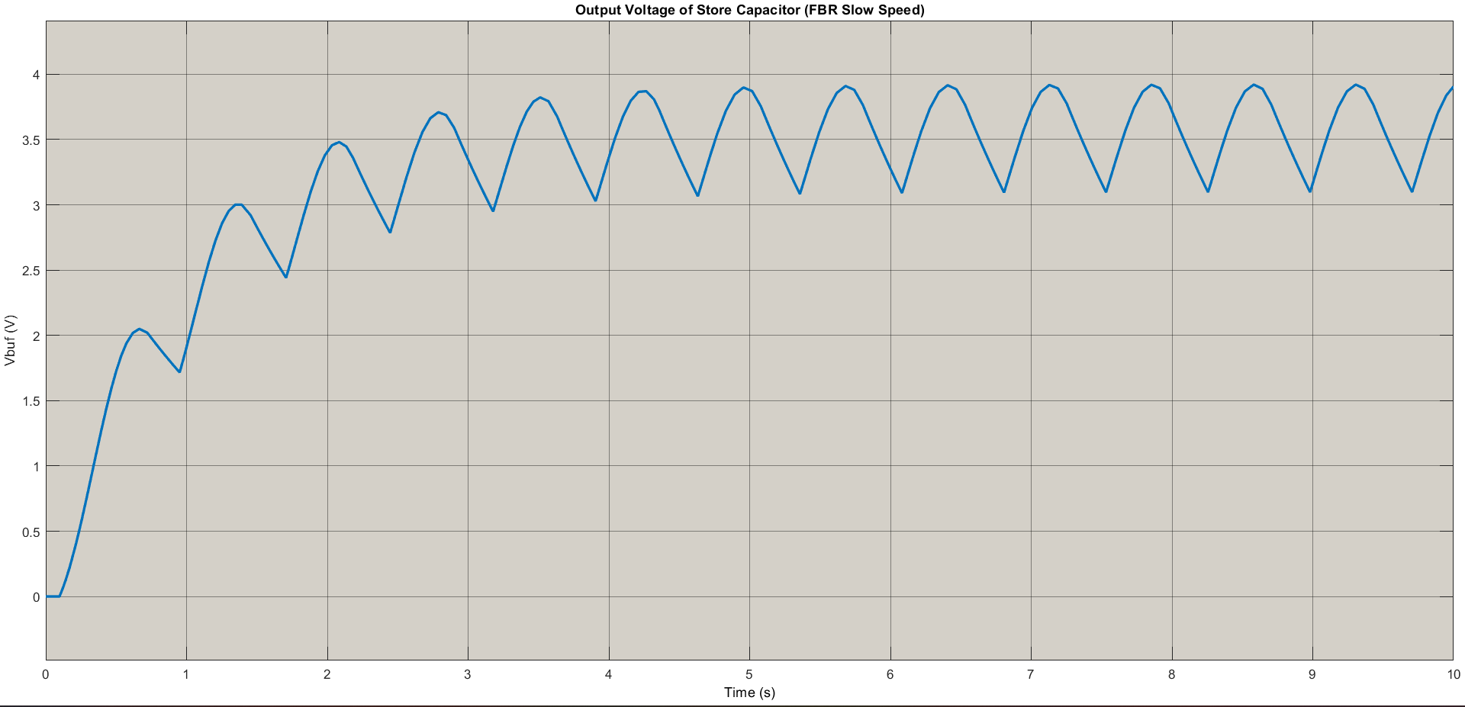
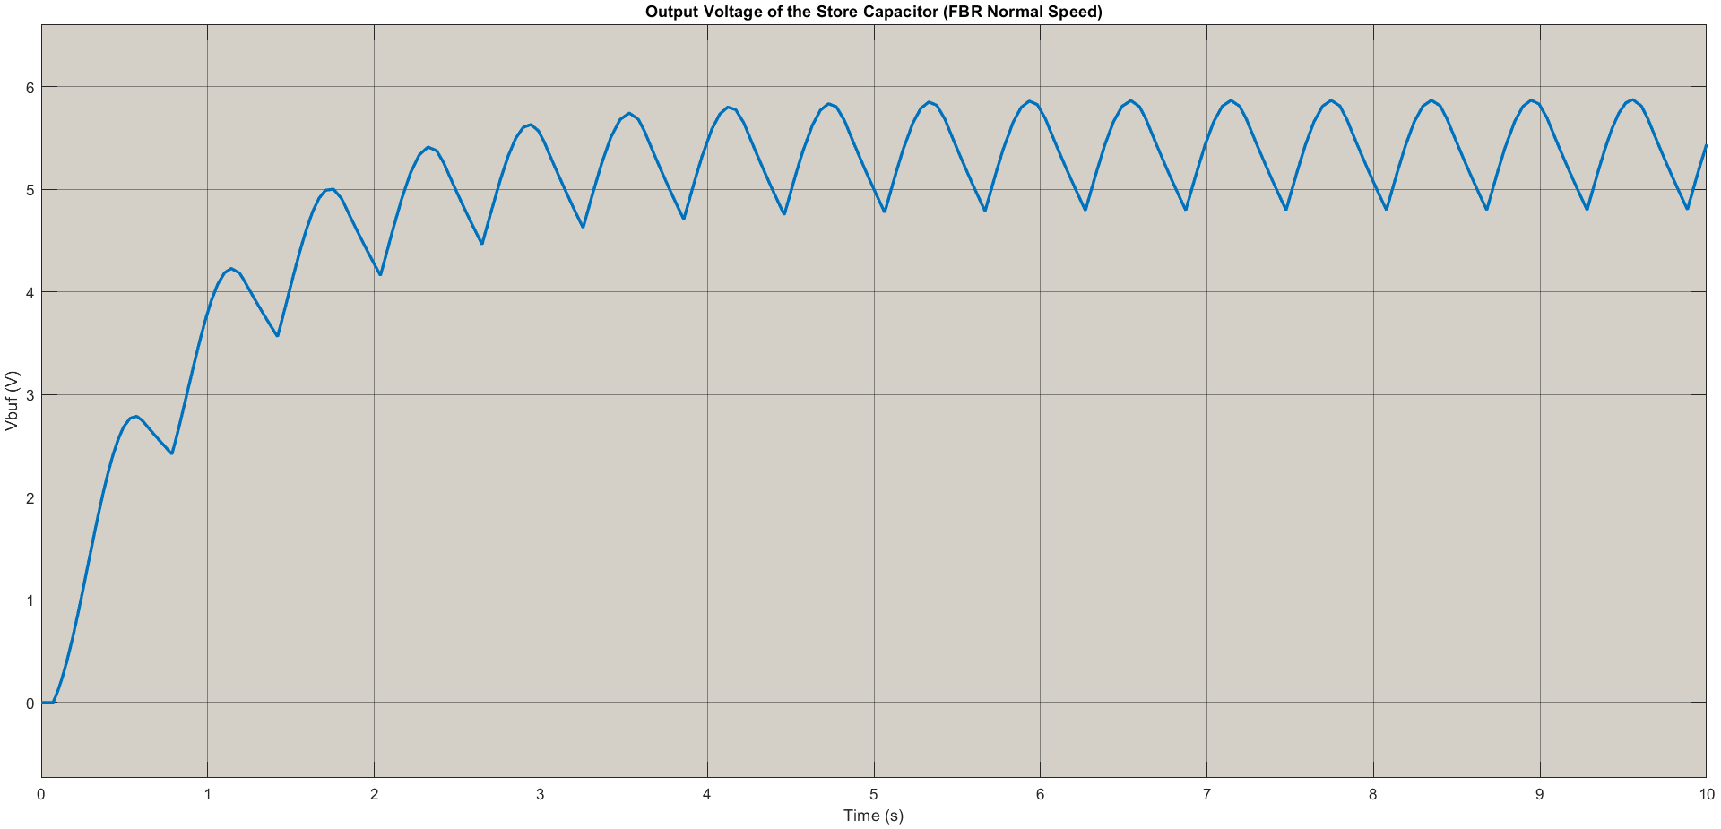
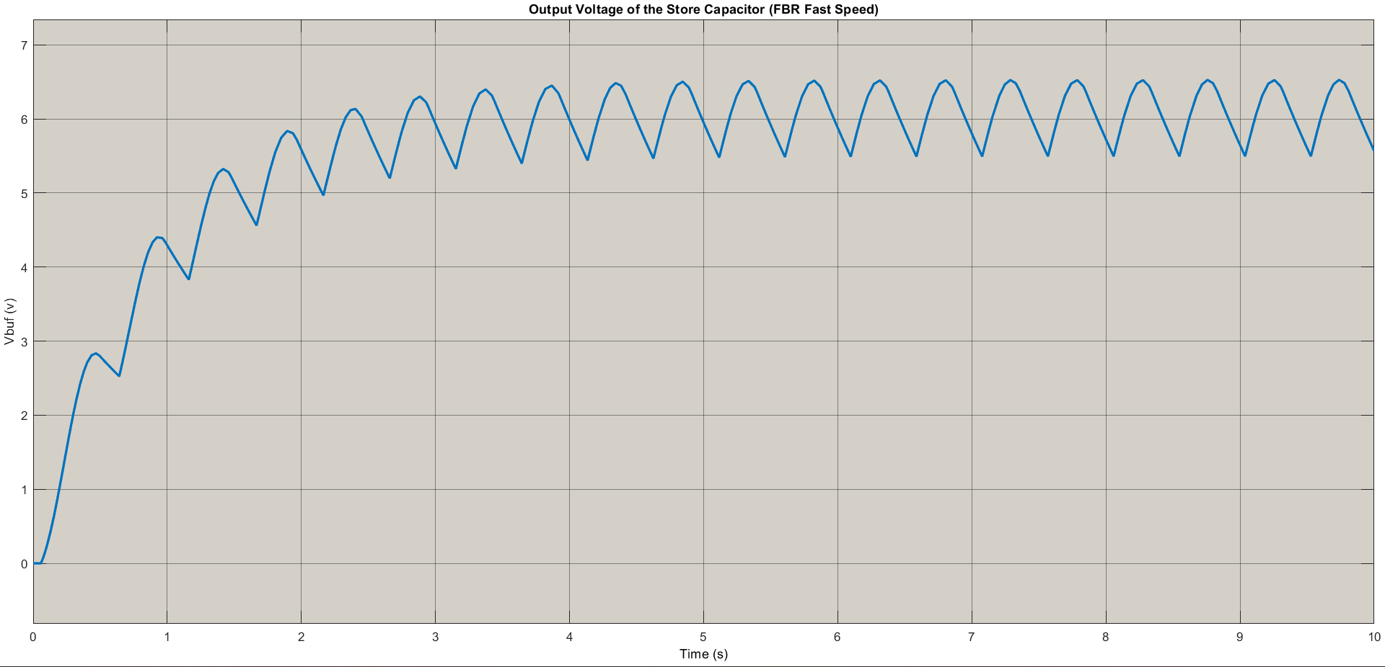
Full-Bridge Rectifier
Output Voltage of Store Capacitor
Slow (2.5 km/h)_3.1V
Normal (4.0 km/h)_4.8V
Fast (5.5 km/h)_5.5V

Slide 16
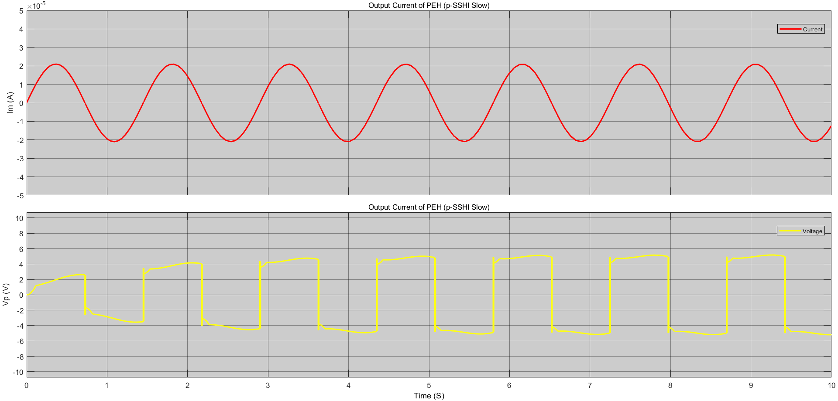
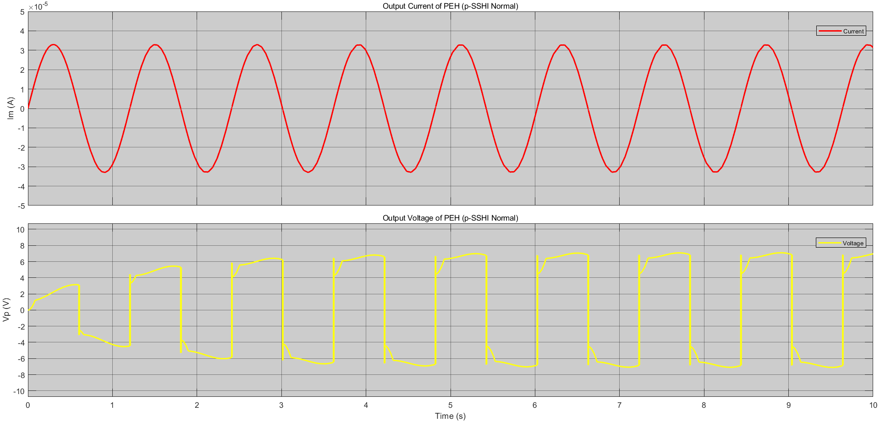
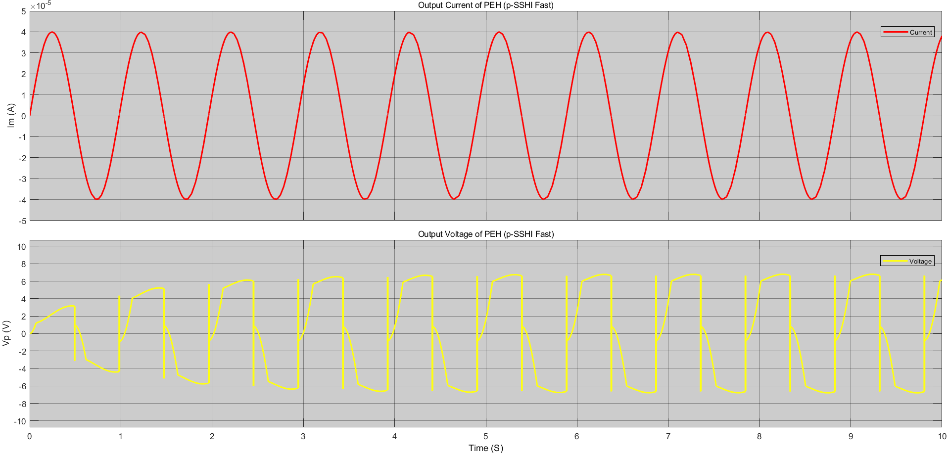
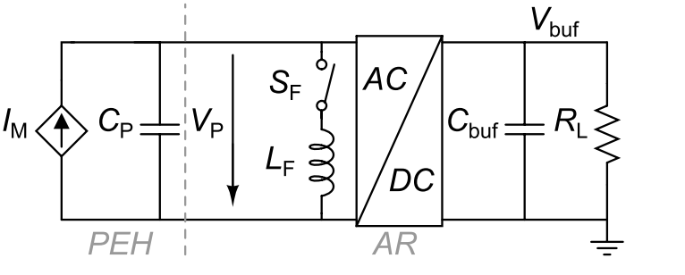
Parallel-SSHI Rectifier
Output Voltage and Current of PEH
Slow (2.5 km/h)
Normal (4.0 km/h)
Fast (5.5 km/h)

Slide 17
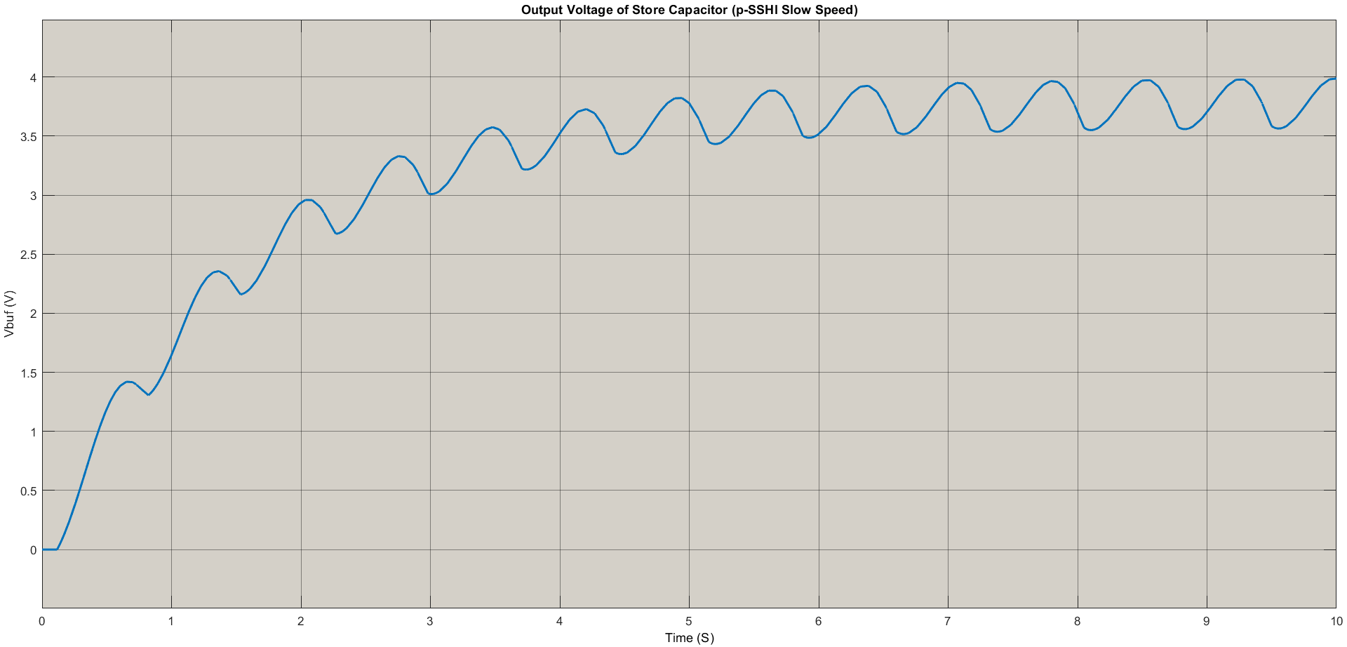
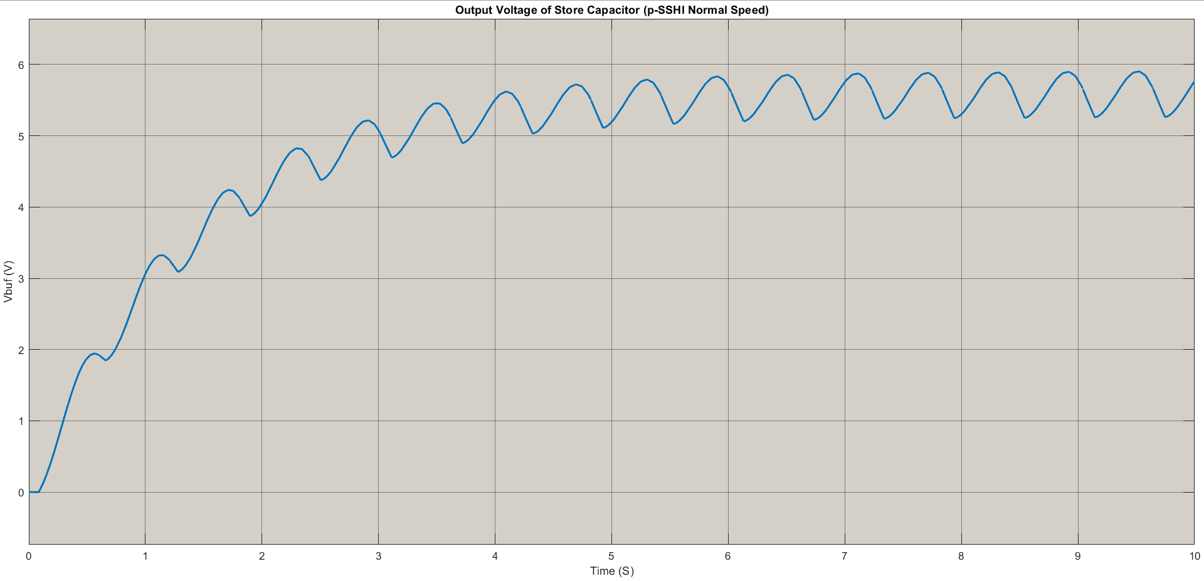
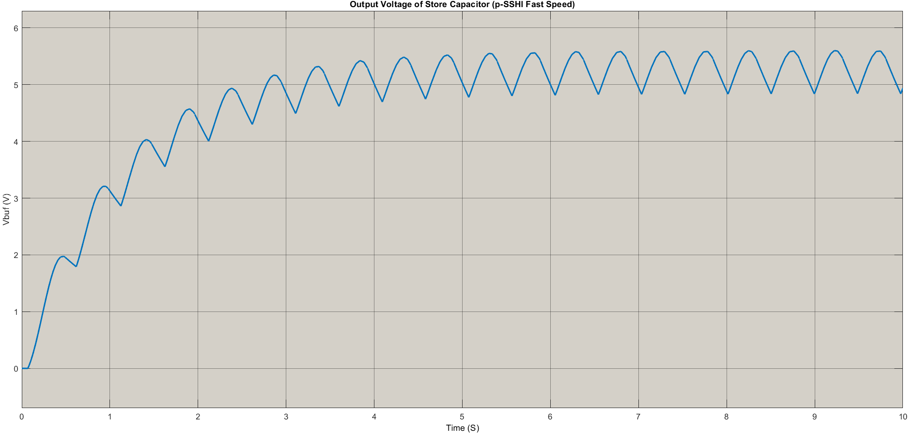
Parallel-SSHI Rectifier
Output Voltage of Store Capacitor
Slow (2.5 km/h)_3.5V
Normal (4.0 km/h)_5.3V
Fast (5.5 km/h)_4.9V

Slide 18
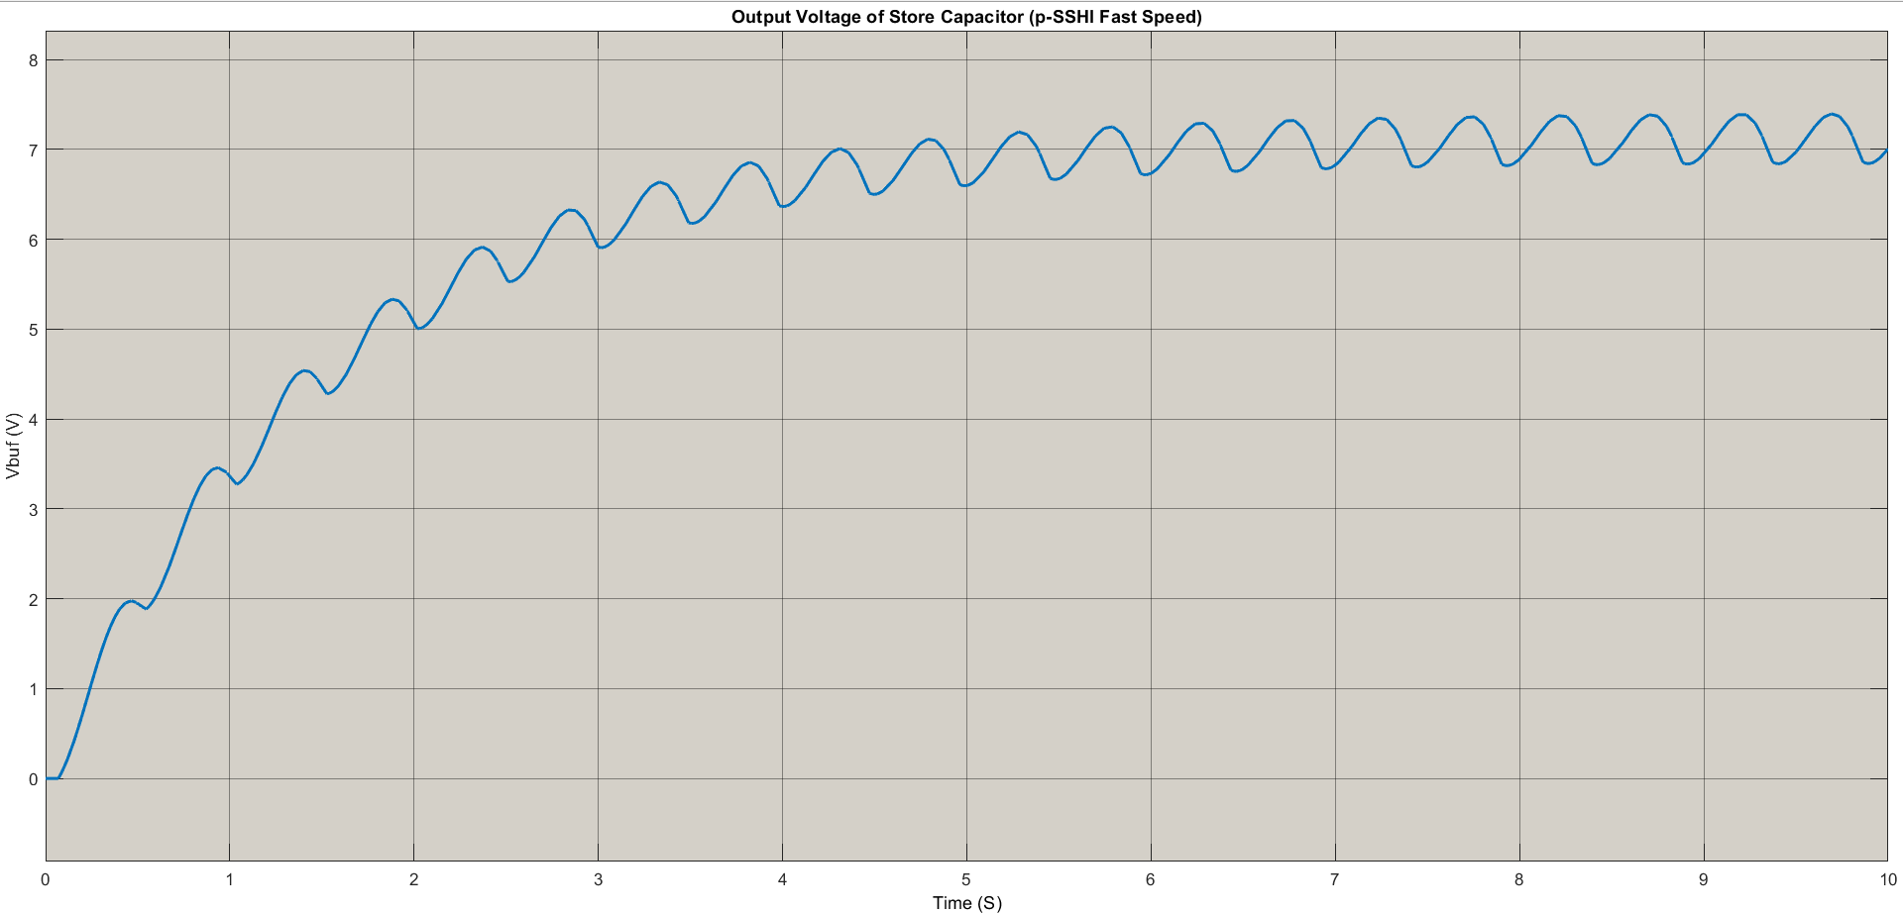
Parallel-SSHI Rectifier
Output Voltage of Store Capacitor
Fast (5.5 km/h)_4.9V_3.3mH
Fast (5.5 km/h)_6.8V_3.6mH

Slide 19
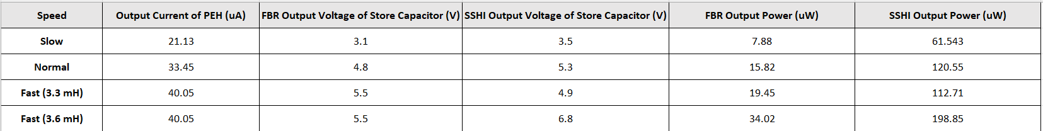
Full-Bridge Rectifier vs. parallel-SSHI rectifier

Slide 20
Trade-offs of the PEH System
Area – Cost, Comfort – Power
Material – Power density, Flexibility (less than 83°)
Rectifier – Output Power, Complexity

Slide 21
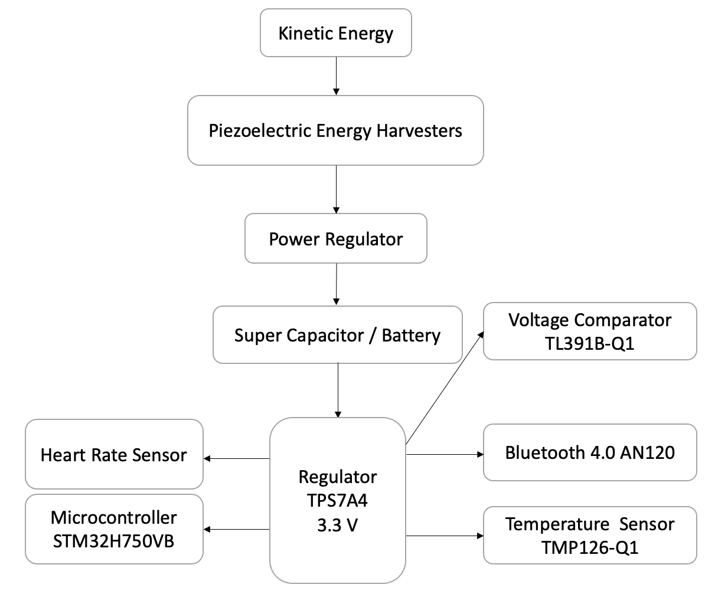
Block Diagram

Slide 22
Energy-Consuming Components
Bluetooth 4.0 AN120--Using CC2590 front end with CC2541
Voltage = 3.3 V, Transmit Current = 27.5 mA, Idle Current = 0.5 uA
Throughput = 0.305 Mb/s, complete once is estimated to be 1s.
Temperature Sensor TMP126-Q1
Voltage = 3.3 V, Current = 0.3 mA
The time to complete a single test is 6 ms.
Microcontroller STM32H750VB
Voltage = 3.3 V, Active Power = 89.1 uW, Idle Power = 0.445 uW.
Voltage comparator TL391B-Q1
Voltage = 3.3 V，Current = 2 uA.
Photoplethysmography Heart-Rate Sensor
Voltage = 3.3 V, Active Power = 547.4 uW, Idle Power = 38.2 uW.
The time to complete a single test is 5 s.
Regulator TPS7A4
Input voltage = 1.6 V - 6.0 V, Output voltage = 0.8 V - 5.5 V
Current = 6.5 μA.

Slide 23
Energy-Consuming Model Running Times
Active Status | Rest | Light Activity | Walk | Fast Walk | Run
Bluetooth | Never | Per 2 hour | Per hour | Per 30 mins | Per 30 mins
Temperature Sensor | Per hour | Per hour | Per hour | Per 30 mins | Per 30 mins
Microcontroller | With Other | With Other | With Other | With Other | With Other
Voltage comparator | Always | Always | Always | Always | Always
Photoplethysmograpy Heart-Rate Sensor | Per hour | Per 20 mins | Per 10 mins | Per 5 mins | Per 2 mins

Slide 24
Energy-Consuming Model Duty Cycle
Active Status | Rest | Light Activity | Walk | Fast Walk | Run
Bluetooth | 0 | 0.0001 | 0.0003 | 0.0006 | 0.0006
Temperature Sensor | 0.00000167 | 0.00000167 | 0.00000167 | 0.00000333 | 0.00000333
Microcontroller | 0.0014 | 0.0042 | 0.0083 | 0.0168 | 0.042
Voltage comparator | 1 | 1 | 1 | 1 | 1
Photoplethysmograpy Heart-Rate Sensor | 0.0014 | 0.0042 | 0.0083 | 0.0168 | 0.042
Power (uW) | 38 | 54 | 78 | 103 | 267

Slide 25
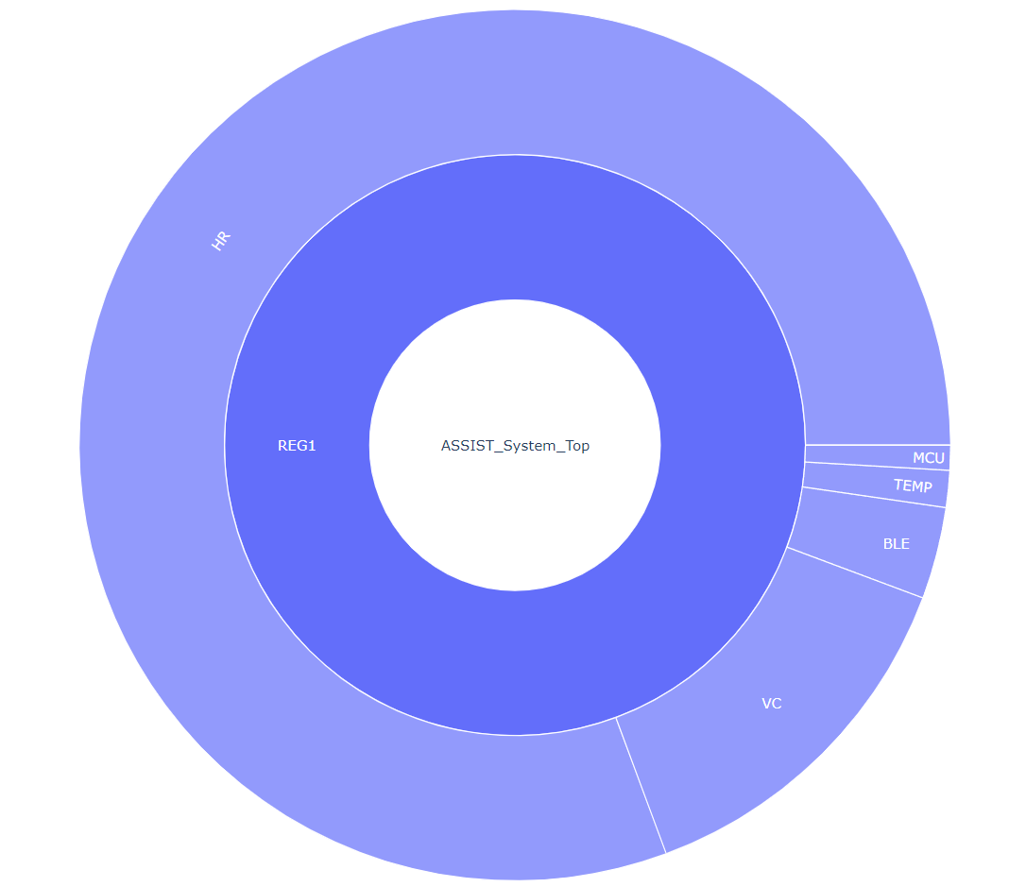
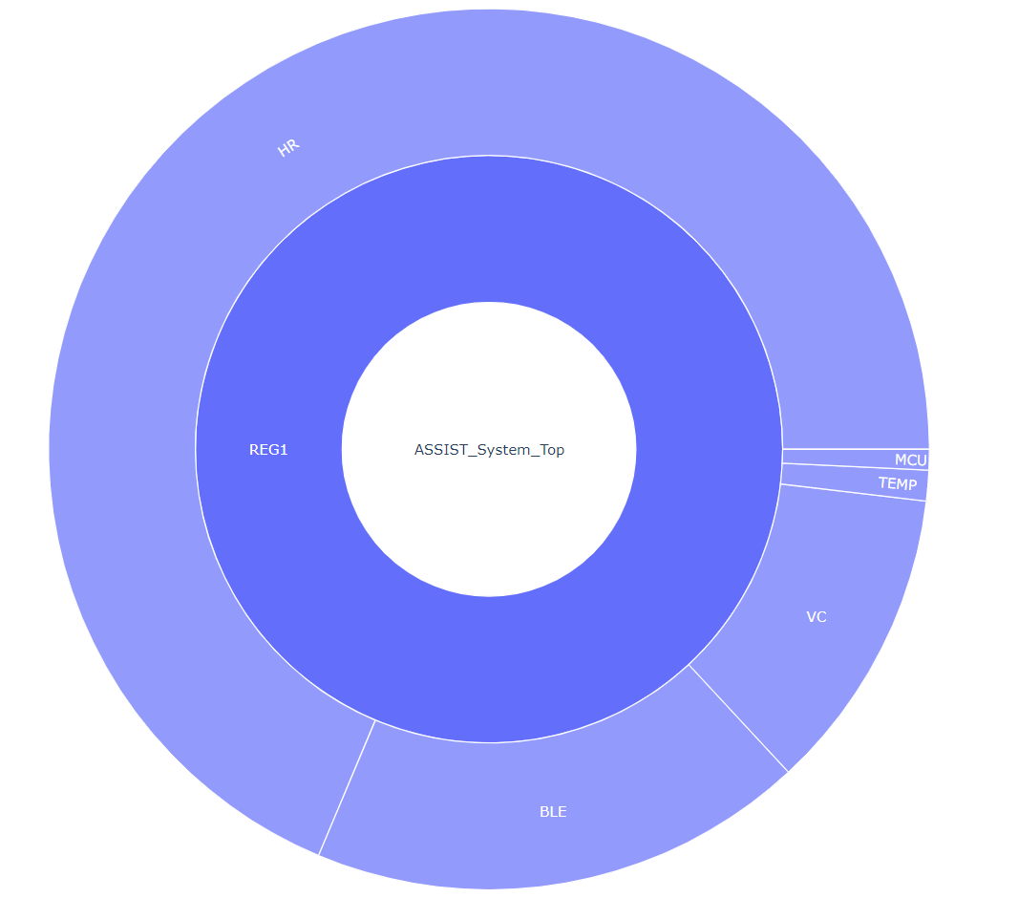
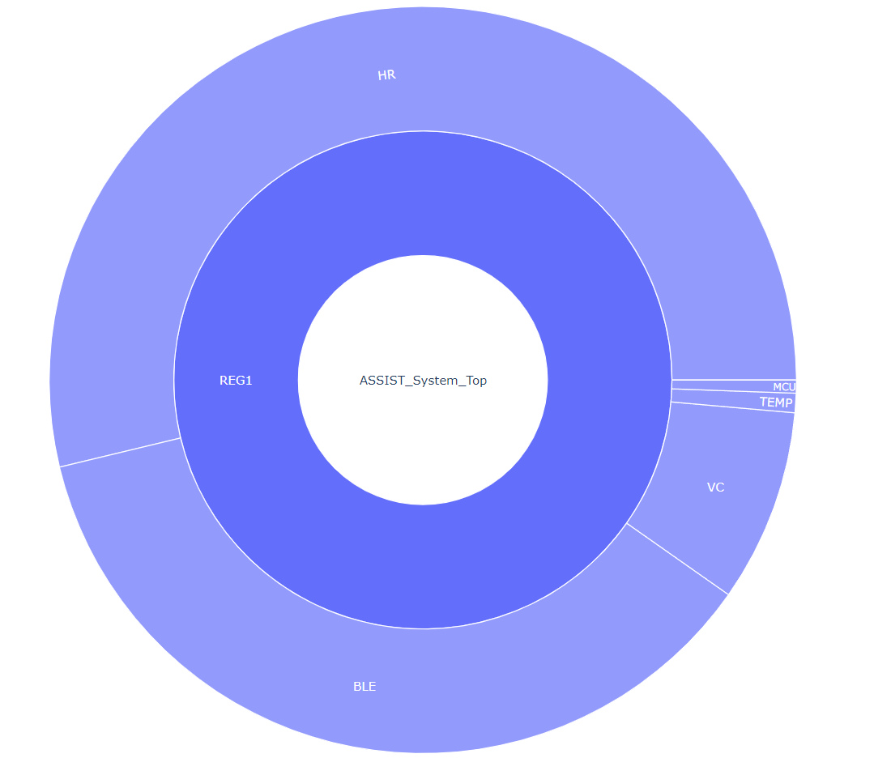
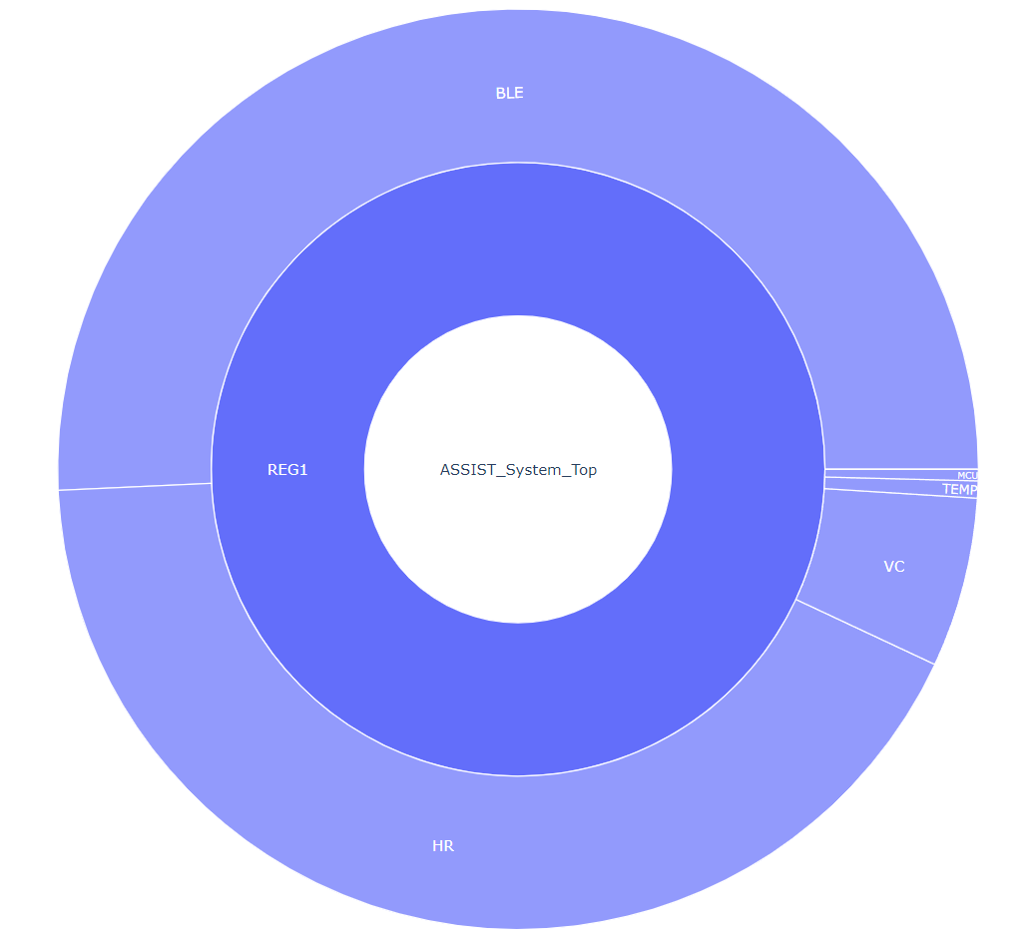
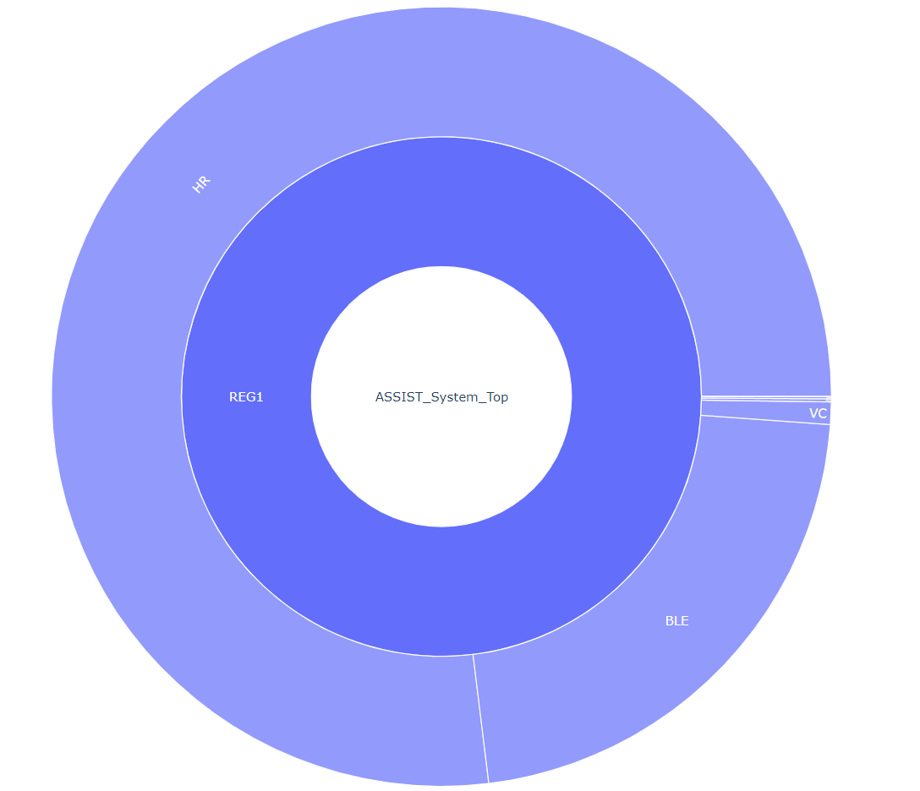
Energy-Consuming Model

Slide 26
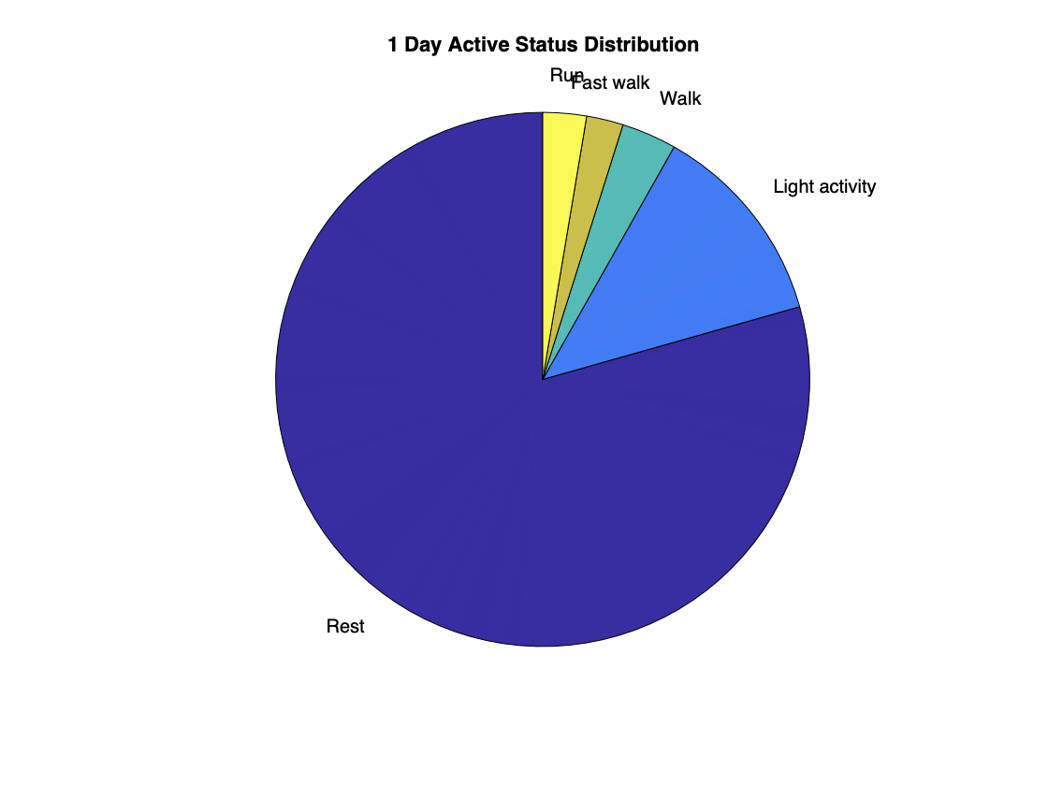
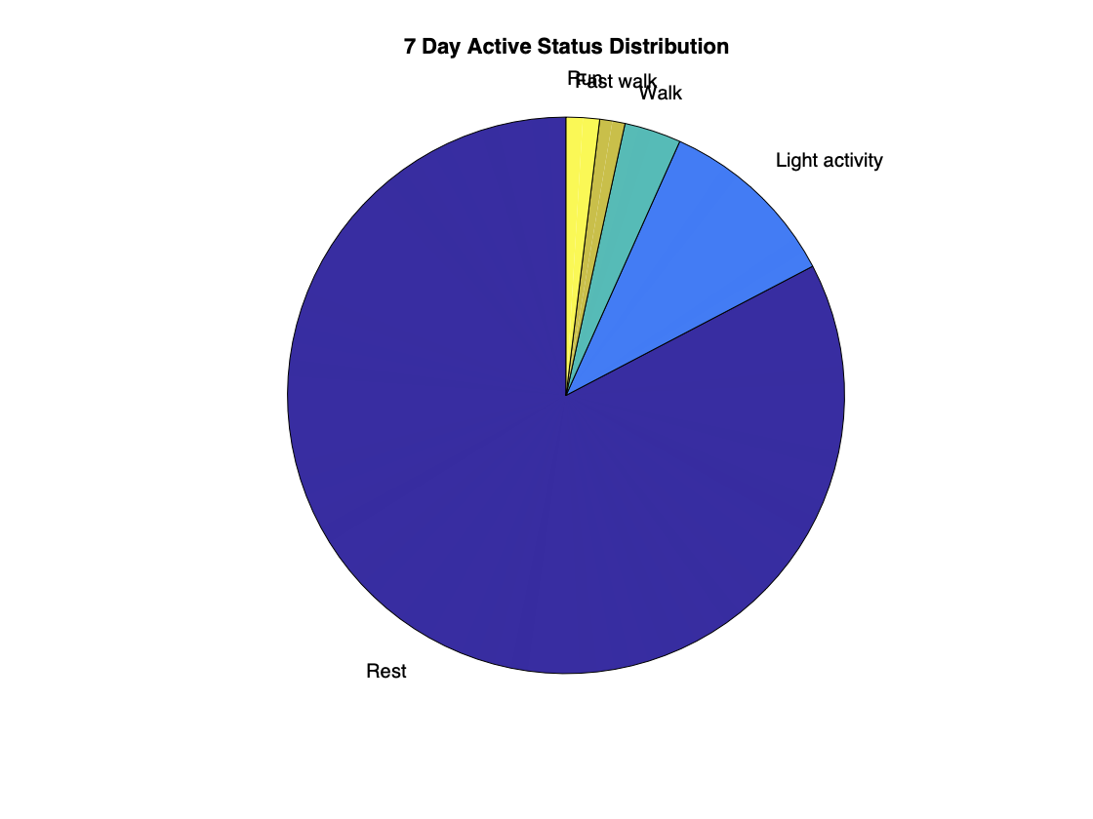
Active Status
Active Status | Rest | Light Activity | Walk | Fast Walk | Run
Step Range | 0 | 1- 40 | 41 - 80 | 81 - 110 | > 110
Energy Harvested Power / Step (uW) | 0 | 63.32 | 89.19 | 145.24 | 194.95
Energy Consumption Power (uW) | 38 | 54 | 78 | 103 | 267

Slide 27
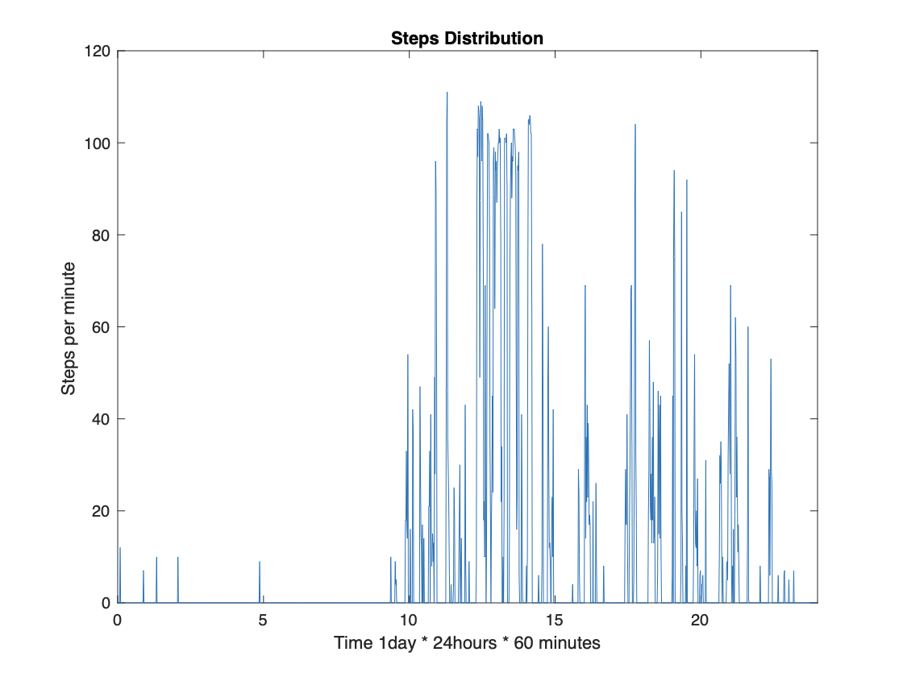
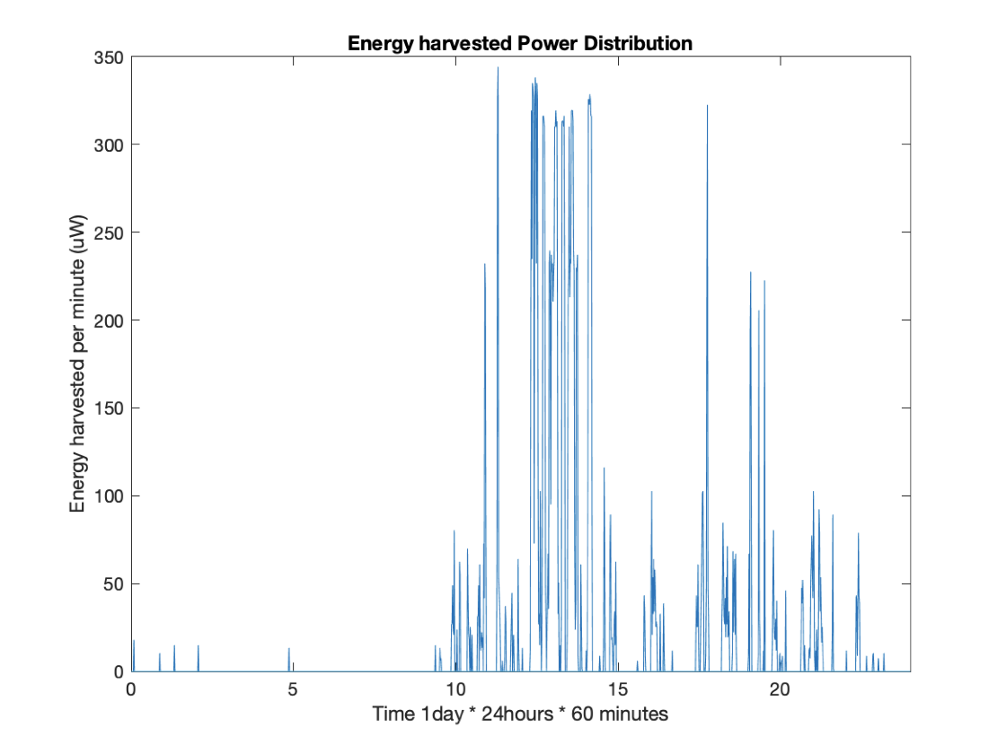
1 Day steps and Energy Harvested Simulation

Slide 28
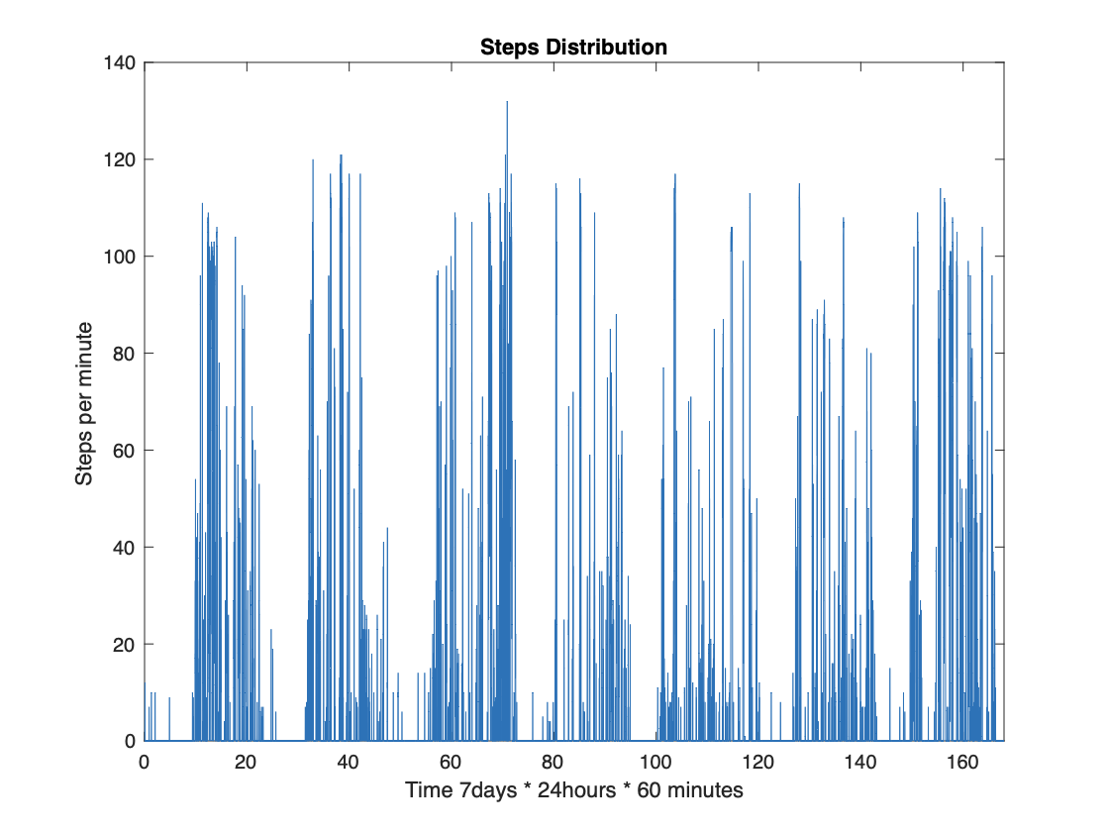
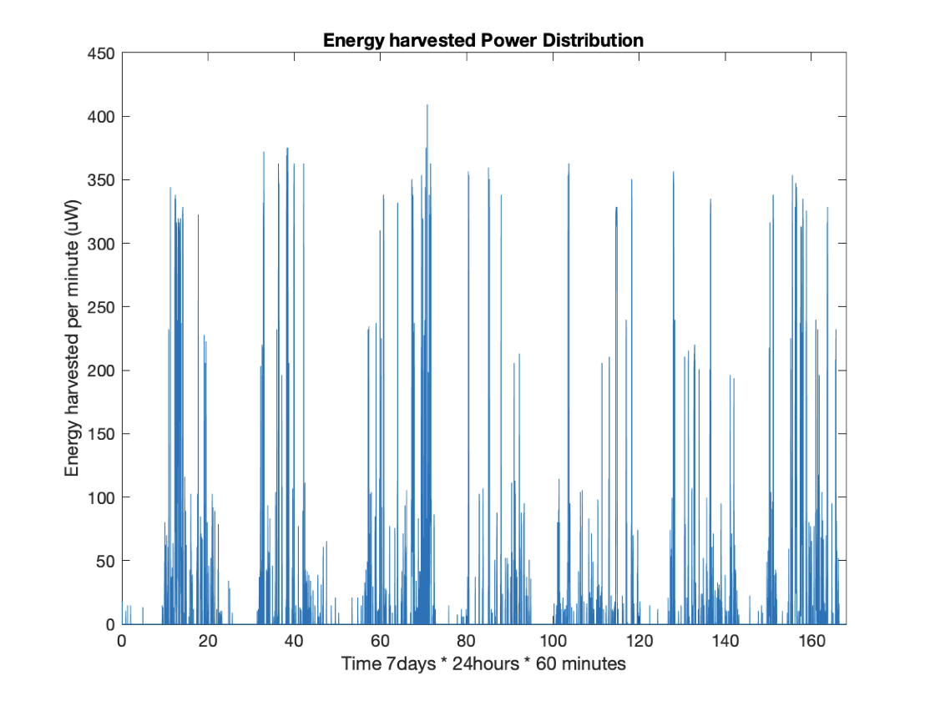
7 Day steps and Energy Harvested Simulation

Slide 29
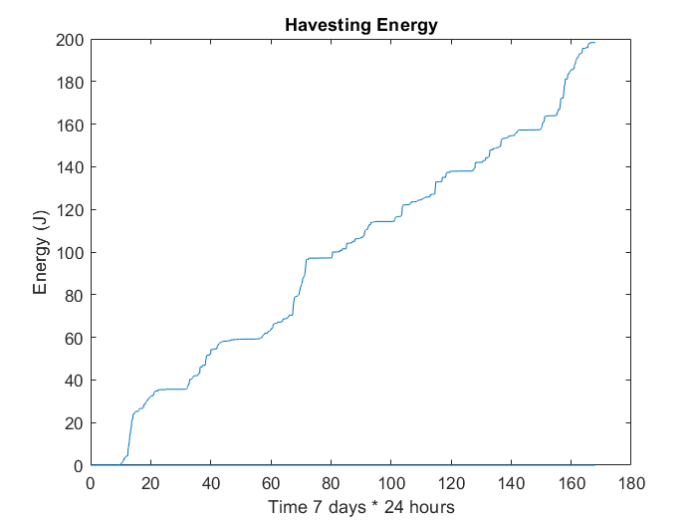
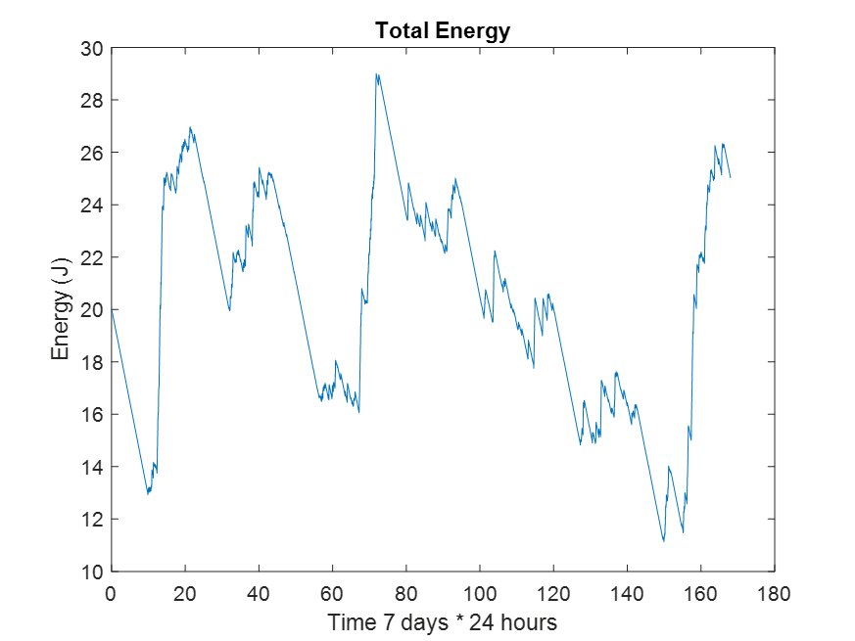
7 Day Energy Change

Slide 30
Conclusion
The model of Piezoelectric energy harvesting system
Full Bridge Rectifier vs. Parallel SSHI Rectifier
Select the appropriate device to build the system.
Complete system analysis, delineate situation discussion

Slide 31
Reference
https://www.ti.com/solution/global-positioning-system-receiver?keyMatch=LOW%20POWER%20GPS
https://ieeexplore.ieee.org/document/9492851
https://ieeexplore.ieee.org/document/7742379
https://iopscience.iop.org/article/10.1088/1742-6596/1052/1/012113/pdf
https://ieeexplore.ieee.org/document/9258908
https://ieeexplore.ieee.org/document/8452343
https://www.mdpi.com/1424-8220/14/7/12497 Inertial Kinetic Energy Harvesters for Wearables:The Benefits of Energy Harvesting at the Foot Christopher Beach_ IEEE Access_2014
https://ieeexplore.ieee.org/document/928763 A Shoe-Embedded Piezoelectric Energy Harvester for Shihao Wen_ IEEE/ASME International Conference on AIM_2018 Wearable Sensors
https://ieeexplore.ieee.org/document/1355442 Design of a Novel Piezoelectric Energy Harvester for Scavenging Energy from Human Walking Design of a Novel Piezoelectric Energy Harvester for Scavenging Energy from Human Walking
https://www.sciencedirect.com/science/article/pii/S0360544219318353 Shihao Wen_ IEEE/ASME International Conference on AIM_2018 Shihao Wen_ IEEE/ASME International Conference on AIM_2018
https://aip.scitation.org/doi/full/10.1063/1.4979832 Evaluation of motions and actuation methods for biomechanical energy harvesting N.S. Shenck_IEEE Micro_2001
https://iopscience.iop.org/article/10.1088/1361-6463/aa7b28 P. Niu_IEEE 35th Annual Power Electronics Specialists Conference_2004 ENERGY SCAVENGING WITH SHOE-MOUNTED PIEZOELECTRICS
https://ieeexplore.ieee.org/document/7360937 FengQian_ScienceDirect Energy_2019 Piezoelectric energy harvesting from human walking using a two-stage amplification mechanism
https://ieeexplore.ieee.org/document/8410909 Yang Kuang_Journal of Physics D: Applied Physics_2017 Scavenging energy from human walking through a shoe-mounted piezoelectric harvester
https://ieeexplore.ieee.org/stamp/stamp.jsp?tp=&arnumber=8683962 Yang Kuang_Journal of Physics D: Applied Physics_2017 A sandwiched piezoelectric transducer with flex end-caps for energy harvesting in large force environments
https://iopscience.iop.org/article/10.1088/1361-665X/aa7ada Qiaochu Tang_IEEE Transactions on Industrial Electronic_2015 Wireless Alarm Microsystem Self-Powered by Vibration-Threshold-Triggered Energy Harvester
https://ieeexplore.ieee.org/document/8967362 Umar Jamil_ICRAI_2019 A high-efficiency self-powered wireless sensor node for monitoring concerning vibratory events
https://www.mdpi.com/2072-666X/8/2/51 Bongwon Jeong_KITECH_2017 Development of MEMS Multi-Mode Electrostatic Energy Harvester Based on the SOI Process
https://docs.google.com/spreadsheets/d/1j-4QHK7VZDUeZYWvxjzCnCpMKH1LTHliNki_bjxST-Q/edit#gid=0 Li Yi_Journal of Micromechanics and Microengineering_2015 A hybrid electrostatic micro-harvester incorporating in-plane overlap and gap closing mechanisms
https://www.tandfonline.com/doi/full/10.1080/14686996.2019.1569828 Hiroshi Toshiyoshi__Science and Technology of Advanced Materials_2019 MEMS vibrational energy harvesters

